Slide 1
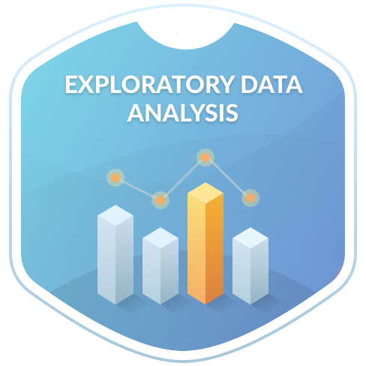
Análisis Exploratorio de Datos
Dr. Lázaro Bustio Martínez
lazaro.bustio@ibero.mx

Slide 2
Agenda
Elementos de la estadística descriptiva
Análisis exploratorio de datos
Identificar los elementos de estadística descriptiva y aplicarlos a un dataset de estudio.

Slide 3
Introduction
In all research, and before drawing conclusions about the objectives and hypotheses proposed, it is necessary to carry out a preliminary and exploratory analysis of the data in order to detect errors in the coding of the variables, eliminate inconsistencies, evaluate the magnitude and type of missing data, learn about the basic characteristics of the distribution of the variables (normality, equality of variances, presence of outliers, linearity, etc.) and make progress on the relationships between them.

Slide 4
Introduction
Tipo de variable | Índices analíticos | Representaciones gráficas
Cuantitativa | media, mediana, moda, desviación típica, rango, amplitud intercuartílica, prueba de normalidad | histograma, gráfico de caja
Cualitativa | frecuencias, porcentajes, moda, etc. | diagrama de barras, diagrama de líneas, diagrama de sectores
Most of these objectives are achieved by performing a descriptive analysis of the variables. Specifically, it is used measures of central tendency and dispersion to describe the characteristics of quantitative variables and tables of frequencies and percentages for qualitative variables.
Notes:
Media aritmética:
· Moda: valor(es) de la variable que más se repite(n).
· Mediana: es que deja el mismo número de observaciones a su derecha que a su izquierda.
· Cuantiles: valores que dividen a la distribución, una vez ordenada ésta de menor a mayor, en intervalos de igual frecuencia. Los más usuales son los cuartiles, C1, C2 y C3, que dividen a la distribución en cuatro intervalos, cada uno de ellos con el 25% de las observaciones; los deciles, D1, D2, ….D9, que dividen la distribución en diez partes iguales, y los percentiles, P1, P2, … P99, que la dividen en cien partes iguales.
· Media truncada: es la media de la variable eliminando el 5% de las colas inferior y superior de la distribución, de esta forma se eliminan valores extremos y es por tanto un estadístico robusto.
· M-estimadores: son estadísticos robustos pues se definen ponderando cada valor de la distribución en función de su distancia al centro de la misma. Las observaciones centrales se ponderan por el máximo valor (la unidad) disminuyendo los coeficientes de ponderación a medida que las observaciones se alejan del centro. Existen distintas formas de ponderar lo cual clasifica a los M-estimadores en: Humbert (pondera con valor uno los valores situados a menos de 1´339 de la mediana), Tukey (pondera con cero los valores situados a 4´385 de la mediana), Andrews (pondera con cero los situados a 4´2066 de la mediana), etc.
De todas las medidas de posición, sólo la moda y los cuantiles (de los cuales la mediana es un caso particular) podrían calcularse para atributos en escala ordinal, y únicamente la moda si la escala fuera nominal.

Slide 5
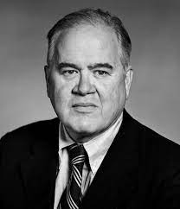
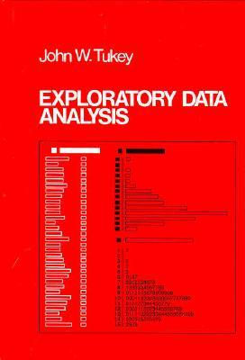
Exploratory Data Analysis 1977
Based on insights developed at Bell Labs in the 60’s.
Technique for visualizing and summarizing data.
What can the data tell us? (in contrast to “confirmatory” data analysis)
Introduced many basic techniques:
5-number summary, box plots, stem and leaf diagrams.
5 number summary:
Extremes (min and max)
Median and quartiles

Slide 6
Aim of the EDA
Maximize insight into a dataset
01
Uncover underlying structure
02
Extract important variables
03
Detect outliers and anomalies
04
Test underlying assumptions
05
Develop valid models
06
Determine optimal factor settings (Xs)
07

Slide 7
Aim of the EDA
The goal of EDA is to open-mindedly explore data.
Tukey: EDA is detective work… Unless detective finds the clues, judge or jury has nothing to consider.
Here, judge or jury is a confirmatory data analysis
Tukey: Confirmatory data analysis goes further, assessing the strengths of the evidence.
With EDA, we can examine data and try to understand the meaning of variables. What are the abbreviations stand for.

Slide 8
Exploratory vs Confirmatory Data Analysis
EDA | CDA
No hypothesis at first Generate hypothesis Uses graphical methods (mostly) | Start with hypothesis Test the null hypothesis Uses statistical models
Descriptive Statistics Graphical Data driven | Inferential Statistics EDA and theory driven

Slide 9
Pipleline of EDA
Generate good research questions
Data restructuring: You may need to make new variables from the existing ones.
Instead of using two variables, obtaining rates or percentages of them
Creating dummy variables for categorical variables
Based on the research questions, use appropriate graphical tools and obtain descriptive statistics. Try to understand the data structure, relationships, anomalies, unexpected behaviors.
Try to identify confounding variables, interaction relations and multicollinearity, if any.
Handle missing observations
Decide on the need of transformation (on response and/or explanatory variables).
Decide on the hypothesis based on your research questions

Slide 10
After EDA
Confirmatory Data Analysis: Verify the hypothesis by statistical analysis
Get conclusions and present your results nicely.

Slide 11
Classification of EDA*
Exploratory data analysis is generally cross-classified in two ways. First, each method is either non-graphical or graphical. And second, each method is either univariate or multivariate (usually just bivariate).
Non-graphical methods generally involve calculation of summary statistics, while graphical methods obviously summarize the data in a diagrammatic or pictorial way.
Univariate methods look at one variable (data column) at a time, while multivariate methods look at two or more variables at a time to explore relationships. Usually, our multivariate EDA will be bivariate (looking at exactly two variables), but occasionally it will involve three or more variables.
It is almost always a good idea to perform univariate EDA on each of the components of a multivariate EDA before performing the multivariate EDA.
*Seltman, H.J. (2015). Experimental Design and Analysis. http://www.stat.cmu.edu/~hseltman/309/Book/Book.pdf

Slide 12
Types of exploratory data analysis
Other common types of multivariate graphics include:
Scatter plot, which is used to plot data points on a horizontal and a vertical axis to show how much one variable is affected by another.
Multivariate chart, which is a graphical representation of the relationships between factors and a response.
Run chart, which is a line graph of data plotted over time.
Bubble chart, which is a data visualization that displays multiple circles (bubbles) in a two-dimensional plot.
Heat map, which is a graphical representation of data where values are depicted by color.

Slide 13
Example
Data from the Places Rated Almanac (Boyer and Savageau, 1985) 9 variables from 329 metropolitan areas in the USA:
Climate mildness
Housing cost
Health care and environment
Crime
Transportation supply
Educational opportunities and effort
Arts and culture facilities
Recreational opportunities
Personal economic outlook
+ latitude and longitude of each city
Questions:
How is climate related to location?
Are there clusters in the data (excluding location)?
Are nearby cities similar?
Any relation between economic outlook and crime?
What else???

Slide 14
What is data?
Categorical (Qualitative)
Nominal scales – number is just a symbol that identifies a quality
0=male, 1=female
1=green, 2=blue, 3=red, 4=white
Ordinal – rank order
Quantitative (continuous and discrete)
Interval – units are of identical size (i.e., Years)
Ratio – distance from an absolute zero (i.e., Age, reaction time)

Slide 15
What is a measurement?
Every measurement has 2 parts:
The True Score (the actual state of things in the world)
and
ERROR! (mistakes, bad measurement, report bias, context effects, etc.)
X = T + e

Slide 16
Organizing your data in a spreadsheet
Subject | condition | score
1 | before | 3
1 | during | 2
1 | after | 5
2 | before | 3
2 | during | 8
2 | after | 4
3 | before | 3
3 | during | 7
3 | after | 1
Stacked data:
Multiple cases (rows) for each subject
Unstacked data:
Only one case (row) per subject
Subject | before | during | after
1 | 3 | 2 | 5
2 | 3 | 8 | 4
3 | 3 | 7 | 1

Slide 17
Variable Summaries
Indices of central tendency:
Mean – the average value
Median – the middle value
Mode – the most frequent value
Indices of Variability:
Variance – the spread around the mean
Standard deviation
Standard error of the mean (estimate)

Slide 18

The Mean
Subject | before | during | after
1 | 3 | 2 | 7
2 | 3 | 8 | 4
3 | 3 | 7 | 3
4 | 3 | 2 | 6
5 | 3 | 8 | 4
6 | 3 | 1 | 6
7 | 3 | 9 | 3
8 | 3 | 3 | 6
9 | 3 | 9 | 4
10 | 3 | 1 | 7
Mean = sum of all scores divided by number of scores:
$$\overline{x}=\frac{1}{n}\sum_{i=1}^{n}{x_{i}}$$
Sum = 30 50 50
n = 10 10 10
Mean = 3 5 5

Slide 19


The Variance: Sum of the squared deviations divided by number of scores
In probability theory and statistics, variance is the expectation of the squared deviation of a random variable from its mean. Variance is a measure of dispersion, meaning it is a measure of how far a set of numbers is spread out from their average value.
$$s=\frac{1}{n}\sum_{i=1}^{n}{{\left(x_{i}−\overline{x}\right)}^{2}}$$

Slide 20
The Variance: Sum of the squared deviations divided by number of scores
Subject | before | during | after
1 | 3 | 2 | 7
2 | 3 | 8 | 4
3 | 3 | 7 | 3
4 | 3 | 2 | 6
5 | 3 | 8 | 4
6 | 3 | 1 | 6
7 | 3 | 9 | 3
8 | 3 | 3 | 6
9 | 3 | 9 | 4
10 | 3 | 1 | 7
Before -mean | Before – mean² | During - mean | During – mean² | After - mean | After – mean²
0 | 0 | -3 | 9 | 2 | 4
0 | 0 | 3 | 9 | -1 | 1
0 | 0 | 2 | 4 | -2 | 4
0 | 0 | -3 | 9 | 1 | 1
0 | 0 | 3 | 9 | -1 | 1
0 | 0 | -4 | 16 | 1 | 1
0 | 0 | 4 | 16 | -2 | 4
0 | 0 | -2 | 4 | 1 | 1
0 | 0 | 4 | 16 | -1 | 1
0 | 0 | -4 | 16 | 2 | 4
Sum = 30 50 50
n = 10 10 10
Mean = 3 5 5
0 0 0 108 0 22
10 10 10
VAR = 0 10.8 2.2
Notes:
Before-mean = before - mean: 3 – 3 = 0
During-mean = during – mean: 2 – 5 = -3

Slide 21
Variance continued
mean

Slide 22
Distribution
Means and variances are ways to describe a distribution of scores.
Knowing about your distributions is one of the best ways to understand your data.
A NORMAL (aka Gaussian) distribution is the most common assumption of statistics; thus, it is often important to check if your data are normally distributed.

Slide 23
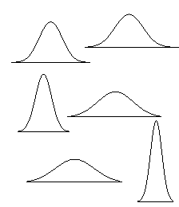
What is “normal” anyway?
With enough measurements, most variables are distributed normally.
But in order to fully describe data we need to introduce the idea of a standard deviation.
leptokurtic
platokurtic

Slide 24
Standard deviation
Variance, as calculated earlier, is arbitrary.
What does it mean to have a variance of 10.8? Or 2.2? Or 1459.092? Or 0.000001?
Nothing. But if you could “standardize” that value, you could talk about any variance (i.e., deviation) in equivalent terms.
Standard Deviations are simply the square root of the variance.

Slide 25

Standard deviation
The process of standardizing deviations goes like this:
$$=\sqrt[2]{\frac{1}{n}\sum_{i=1}^{n}{{\left(x_{i}−\overline{x}\right)}^{2}}}$$
Score (in the units that are meaningful)
Mean
Each score’s deviation from the mean
Square that deviation
Sum all the squared deviations (Sum of Squares)
Divide by n (if population) or n-1 (if sample)
Square root – now the value is in the units we started with!!!
Notes:
Hacer este ejemplo: https://www.mathsisfun.com/data/standard-deviation-formulas.html

Slide 26
Interpreting standard deviation (SD)
First, the SD will let you know about the distribution of scores around the mean.
High SDs (relative to the mean) indicate the scores are spread out
Low SDs tell you that most scores are very near the mean.
High SD
Low SD

Slide 27
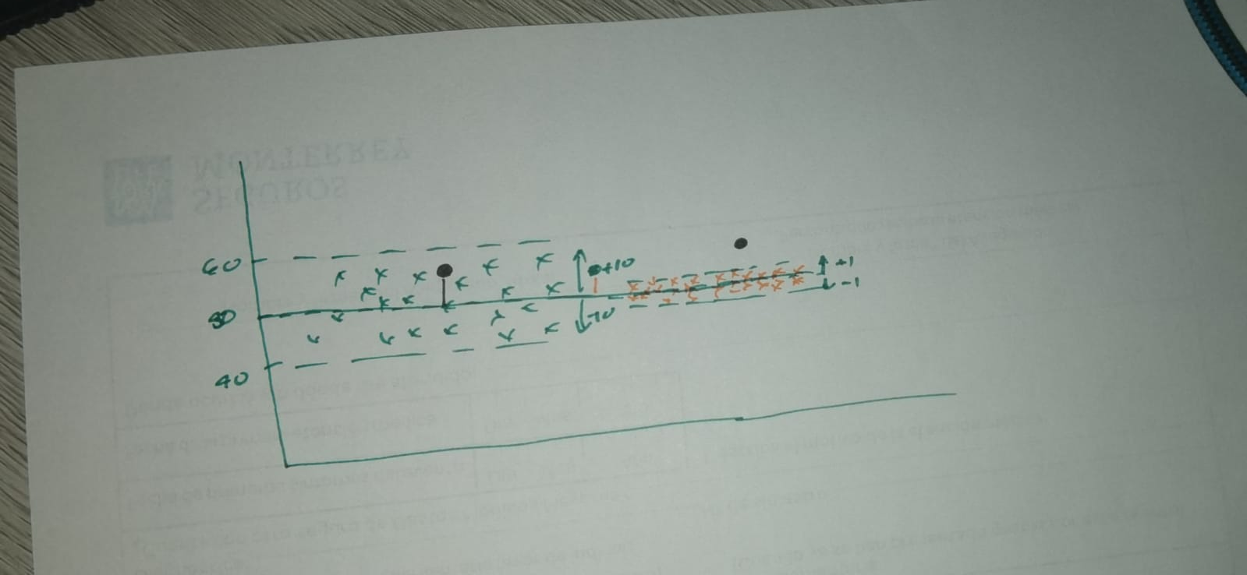
Interpreting standard deviation (SD)
Second, you can then interpret any individual score in terms of the SD.
For example:
mean = 50, SD = 10
versus mean = 50, SD = 1
A score of 55 is:
0.5 Standard deviation units from the mean (not much)
OR
5 standard deviation units from mean (a lot!)

Slide 28

Standardized scores (Z)
Third, you can use SDs to create standardized scores
Force the scores onto a normal distribution by putting each score into units of SD.
Subtract the mean from each score and divide by SD:
$$Z=\frac{\left(x−\overline{x}\right)}{σ}, \overline{x}=,\frac{1}{n}\sum_{i=1}^{n}{x_{i}}, σ=\sqrt[2]{\frac{1}{n}\sum_{i=1}^{n}{{\left(x_{i}−μ\right)}^{2}}}$$
Notes:
Sigma: desviación estandar

Slide 29
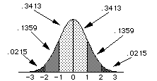
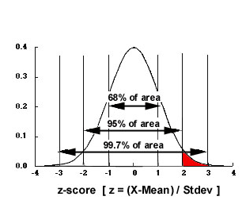
Standardized normal distribution
ALL Z-scores have a mean of 0 and SD of 1. Nice and simple.
From this we can get the proportion of scores anywhere in the distribution.

Slide 30
The trouble with normal
We violate assumptions about statistical tests if the distributions of our variables are not approximately normal.
Thus, we must first examine each variable’s distribution and adjust when necessary, so that assumptions are met.

Slide 31
Following
Examine every variable for:
Out of range values
Normality
Outliers

Slide 32

Checking data
It is necessary to get a table of each variable with each value and its frequency of occurrence.
Best way to examine categorical variables is by checking their frequencies

Slide 33
Visual display of univariate data
Subject | before | during | after
1 | 3.1 | 2.3 | 7
2 | 3.2 | 8.8 | 4.2
3 | 2.8 | 7.1 | 3.2
4 | 3.3 | 2.3 | 6.7
5 | 3.3 | 8.6 | 4.5
6 | 3.3 | 1.5 | 6.6
7 | 2.8 | 9.1 | 3.4
8 | 3 | 3.3 | 6.5
9 | 3.1 | 9.5 | 4.1
10 | 3 | 1 | 7.3
Now the example data from before has decimals
What kind of data is that?
Precision has increased

Slide 34
Visual display of univariate data
Subject | before | during | after
1 | 3.1 | 2.3 | 7
2 | 3.2 | 8.8 | 4.2
3 | 2.8 | 7.1 | 3.2
4 | 3.3 | 2.3 | 6.7
5 | 3.3 | 8.6 | 4.5
6 | 3.3 | 1.5 | 6.6
7 | 2.8 | 9.1 | 3.4
8 | 3 | 3.3 | 6.5
9 | 3.1 | 9.5 | 4.1
10 | 3 | 1 | 7.3
Histograms
Stem and Leaf plots
Boxplots
QQ Plots
…and many many more.

Slide 35
Histograms
# of bins is very important

Slide 36
Boxplots
Upper and lower bounds of boxes are the 25th and 75th percentile (interquartile range)
Whiskers are min and max value unless there is an outlier
An outlier is beyond 1.5 times the interquartile range (box length).

Slide 37
Quantile-Quantile (Q-Q) Plots
Random Normal Distribution
Random Exponential Distribution

Slide 38
Q-Q Plots

Slide 39
So…what do you do?
If you find a mistake, fix it.
If you find an outlier, trim it or delete it.
If your distributions are askew, transform the data.

Slide 40
Dealing with Outliers
First, try to explain it.
In a normal distribution 0.4% are outliers (>2.7 SD) and 1 in a million is an extreme outlier (>4.72 SD).
For analyses you can:
Delete the value – crude but effective
Change the outlier to value ~3 SD from mean
“Winsorize” it (make = to next highest value)
“Trim” the mean – recalculate mean from data within interquartile range

Slide 41
Dealing with skewed distributions
(Skewness and kurtosis greater than +/- 2)
Positive skew is reduced by using the square root or log
Negative skew is reduced by squaring the data values

Slide 42
Visual Display of Bivariate Data
So, you have examined each variable for mistakes, outliers and distribution and made any necessary alterations. Now what?
Look at the relationship between 2 (or more) variables at a time

Slide 43
Visual Displays of Bivariate Data
Variable 1 | Variable 2 | Display Example
Categorical | Categorical | Crosstabs
Categorical | Continuous | Box plots
Continuous | Continuous | Scatter plots

Slide 44
Scales of Graphs
It is very important to pay attention to the scale that you are using when you are plotting.
Compare the following graphs created from identical data

Slide 45
Steps in Data Exploration and Processing
Identification of variables and data types
Analyzing the basic metrics
Non-Graphical Univariate Analysis
Graphical Univariate Analysis
Bivariate Analysis
Variable transformations
Missing value treatment
Outlier treatment
Correlation Analysis
Dimensionality Reduction

Slide 46
Summary
Examine all your variables thoroughly and carefully before you begin analysis
01
Use visual displays whenever possible
02
Transform each variable as necessary to deal with mistakes, outliers, and distributions
03

Slide 47
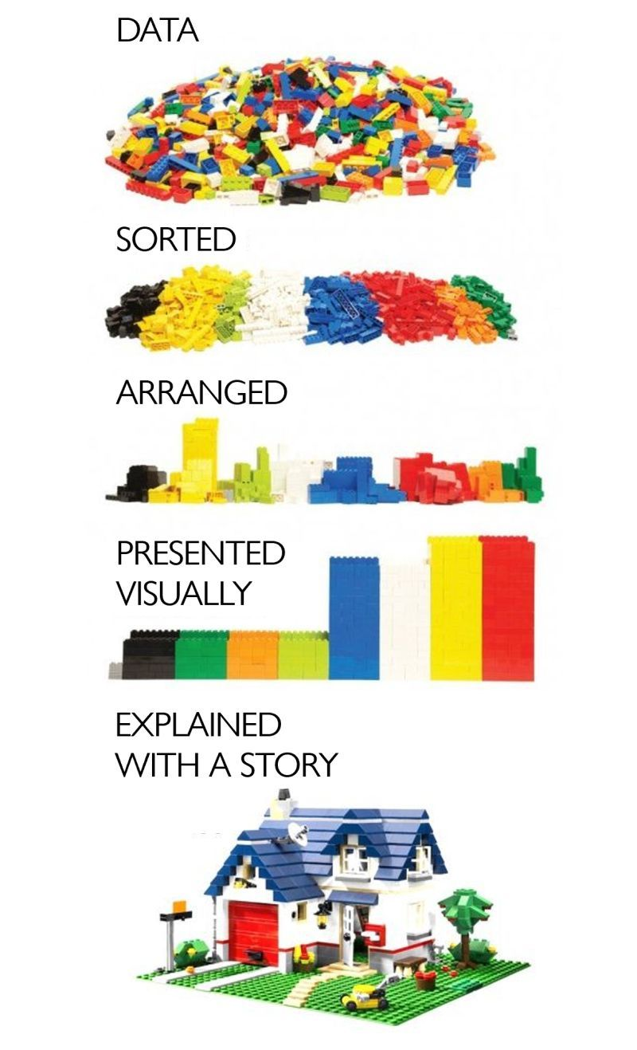
Trabajo con datos

Slide 48
Introducción
Acumulación
de
experiencia
Conocimiento
Formato
Filtro
Resumen
Interpreta
Decide
Dato
Información
Resultados

Slide 49
Why Data Preprocessing?
Data in the real world is dirty
incomplete: lacking attribute values, lacking certain attributes of interest, or containing only aggregate data
e.g., occupation=“”
noisy: containing errors or outliers
e.g., Salary=“-10”
inconsistent: containing discrepancies in codes or names
e.g., Age=“42” Birthday=“03/07/1997”
e.g., Was rating “1,2,3”, now rating “A, B, C”
e.g., discrepancy between duplicate records

Slide 50
Why Is Data Dirty?
Incomplete data comes from
n/a data value when collected
different consideration between the time when the data was collected and when it is analyzed.
human/hardware/software problems
Noisy data comes from the process of data
collection
entry
transmission
Inconsistent data comes from
Different data sources
Functional dependency violation

Slide 51
Why Is Data Preprocessing Important?
No quality data, no quality mining results!
Quality decisions must be based on quality data
e.g., duplicate or missing data may cause incorrect or even misleading statistics.
Data warehouse needs consistent integration of quality data
Data extraction, cleaning, and transformation comprises the majority of the work of building a data warehouse. —Bill Inmon

Slide 52
Multi-Dimensional Measure of Data Quality
A well-accepted multidimensional view:
Accuracy
Completeness
Consistency
Timeliness
Believability
Value added
Interpretability
Accessibility
Broad categories:
intrinsic, contextual, representational, and accessibility.

Slide 53
Major Tasks in Data Preprocessing
Data cleaning
Fill in missing values, smooth noisy data, identify or remove outliers, and resolve inconsistencies
Data integration
Integration of multiple databases, data cubes, or files
Data transformation
Normalization and aggregation
Data reduction
Obtains reduced representation in volume but produces the same or similar analytical results
Data discretization
Part of data reduction but with particular importance, especially for numerical data

Slide 54
Data Cleaning
Importance
“Data cleaning is one of the three biggest problems in data warehousing”—Ralph Kimball
“Data cleaning is the number one problem in data warehousing”—DCI survey
Data cleaning tasks
Fill in missing values
Identify outliers and smooth out noisy data
Correct inconsistent data
Resolve redundancy caused by data integration

Slide 55
Missing Data
Data is not always available
E.g., many tuples have no recorded value for several attributes, such as customer income in sales data
Missing data may be due to
equipment malfunction
inconsistent with other recorded data and thus deleted
data not entered due to misunderstanding
certain data may not be considered important at the time of entry
not register history or changes of the data
Missing data may need to be inferred.

Slide 56
How to Handle Missing Data?
Ignore the tuple: usually done when class label is missing (assuming the tasks in classification—not effective when the percentage of missing values per attribute varies considerably.
Fill in the missing value manually: tedious + infeasible?
Fill in it automatically with
a global constant : e.g., “unknown”, a new class?!
the attribute mean
the attribute mean for all samples belonging to the same class: smarter
the most probable value: inference-based such as Bayesian formula or decision tree

Slide 57
What is Data?
Attributes
Collection of data objects and their attributes
An attribute is a property or characteristic of an object
Examples: eye color of a person, temperature, etc.
Attribute is also known as variable, field, characteristic, or feature
A collection of attributes describe an object
Object is also known as record, point, case, sample, entity, or instance
Objects

Slide 58
Attribute Values
Attribute values are numbers or symbols assigned to an attribute
Distinction between attributes and attribute values
Same attribute can be mapped to different attribute values
Example: height can be measured in feet or meters
Different attributes can be mapped to the same set of values
Example: Attribute values for ID and age are integers
But properties of attribute values can be different
ID has no limit, but age has a maximum and minimum value

Slide 59
Types of Attributes
There are different types of attributes
Nominal
Examples: ID numbers, eye color, zip codes
Ordinal
Examples: rankings (e.g., taste of potato chips on a scale from 1-10), grades, height in {tall, medium, short}
Interval
Examples: calendar dates, temperatures in Celsius or Fahrenheit.
Ratio
Examples: temperature in Kelvin, length, time, counts

Slide 60
Properties of Attribute Values
The type of an attribute depends on which of the following properties it possesses:
Distinctness: = ≠
Order: < >
Addition: + -
Multiplication: * /
Nominal attribute: distinctness
Ordinal attribute: distinctness & order
Interval attribute: distinctness, order & addition
Ratio attribute: all 4 properties

Slide 61
Attribute Type
Description
Examples
Operations
Nominal
The values of a nominal attribute are just different names, i.e., nominal attributes provide only enough information to distinguish one object from another. (=, ≠)
zip codes, employee ID numbers, eye color, sex: {male, female}
mode, entropy, contingency correlation, χ² test
Ordinal
The values of an ordinal attribute provide enough information to order objects. (<, >)
hardness of minerals, {good, better, best}, grades, street numbers
median, percentiles, rank correlation, run tests, sign tests
Interval
For interval attributes, the differences between values are meaningful, i.e., a unit of measurement exists. (+, - )
calendar dates, temperature in Celsius or Fahrenheit
mean, standard deviation, Pearson's correlation, t and F tests
Ratio
For ratio variables, both differences and ratios are meaningful. (*, /)
temperature in Kelvin, monetary quantities, counts, age, mass, length, electrical current
geometric mean, harmonic mean, percent variation

Slide 62
Attribute Level
Transformation
Comments
Nominal
Any permutation of values
If all employee ID numbers were reassigned, would it make any difference?
Ordinal
An order preserving change of values, i.e., new_value = f(old_value) where f is a monotonic function.
An attribute encompassing the notion of good, better best can be represented equally well by the values {1, 2, 3} or by { 0.5, 1, 10}.
Interval
new_value =a * old_value + b where a and b are constants
Thus, the Fahrenheit and Celsius temperature scales differ in terms of where their zero value is and the size of a unit (degree).
Ratio
new_value = a * old_value
Length can be measured in meters or feet.

Slide 63
Discrete and Continuous Attributes
Discrete Attribute
Has only a finite or countably infinite set of values
Examples: zip codes, counts, or the set of words in a collection of documents
Often represented as integer variables.
Note: binary attributes are a special case of discrete attributes
Continuous Attribute
Has real numbers as attribute values
Examples: temperature, height, or weight.
Practically, real values can only be measured and represented using a finite number of digits.
Continuous attributes are typically represented as floating-point variables.

Slide 64
Types of data sets
Record
Data Matrix
Document Data
Transaction Data
Graph
World Wide Web
Molecular Structures
Ordered
Spatial Data
Temporal Data
Sequential Data
Genetic Sequence Data

Slide 65
Important Characteristics of Structured Data
Dimensionality
Curse of Dimensionality
Sparsity
Only presence counts
Resolution
Patterns depend on the scale

Slide 66
Record Data
Data that consists of a collection of records, each of which consists of a fixed set of attributes

Slide 67
Data Matrix
If data objects have the same fixed set of numeric attributes, then the data objects can be thought of as points in a multi-dimensional space, where each dimension represents a distinct attribute
Such data set can be represented by an m by n matrix, where there are m rows, one for each object, and n columns, one for each attribute

Slide 68
Document Data
Each document becomes a “term” vector:
Each term is a component (attribute) of the vector,
The value of each component is the number of times the corresponding term occurs in the document.

Slide 69
Transaction Data
A special type of record data, where each record (transaction) involves a set of items.
For example, consider a grocery store. The set of products purchased by a customer during one shopping trip constitute a transaction, while the individual products that were purchased are the items.

Slide 70
Graph Data
Examples: Generic graph and HTML Links

Slide 71
Chemical Data
Benzene Molecule: C₆H₆

Slide 72
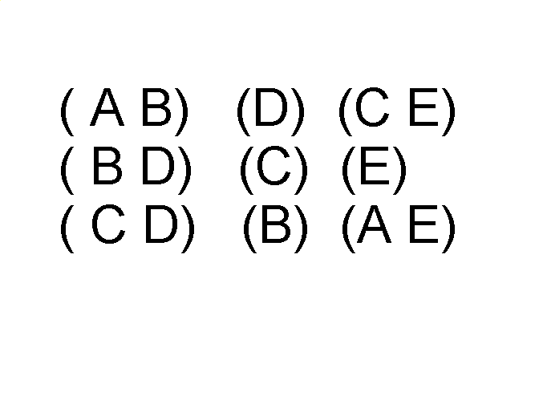
Ordered Data
Sequences of transactions
Items/Events
An element of the sequence

Slide 73
Ordered Data
Genomic sequence data

Slide 74
Ordered Data
Spatio-Temporal Data
Average Monthly Temperature of land and ocean

Slide 75
Data Quality
What kinds of data quality problems?
How can we detect problems with the data?
What can we do about these problems?
Examples of data quality problems:
Noise and outliers
missing values
duplicate data

Slide 76
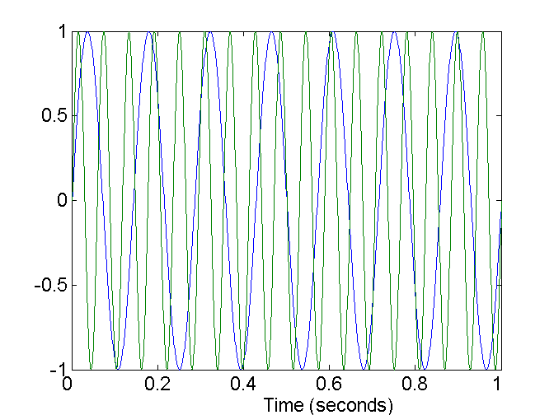
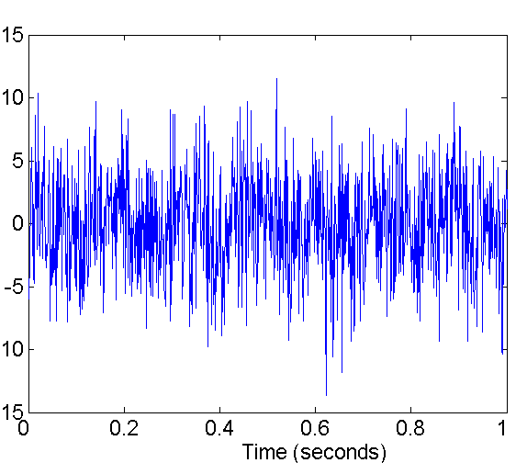
Noise
Noise refers to modification of original values
Examples: distortion of a person’s voice when talking on a poor phone and “snow” on television screen
Two Sine Waves
Two Sine Waves + Noise

Slide 77
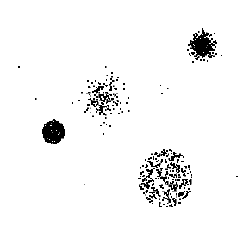
Outliers
Outliers are data objects with characteristics that are considerably different than most of the other data objects in the data set

Slide 78
Missing Values
Reasons for missing values
Information is not collected (e.g., people decline to give their age and weight)
Attributes may not be applicable to all cases (e.g., annual income is not applicable to children)
Handling missing values
Eliminate Data Objects
Estimate Missing Values
Ignore the Missing Value During Analysis
Replace with all possible values (weighted by their probabilities)

Slide 79
Duplicate Data
Data set may include data objects that are duplicates, or almost duplicates of one another
Major issue when merging data from heterogenous sources
Examples:
Same person with multiple email addresses
Data cleaning
Process of dealing with duplicate data issues

Slide 80
Noisy Data
Noise: random error or variance in a measured variable
Incorrect attribute values may be due to
faulty data collection instruments
data entry problems
data transmission problems
technology limitation
inconsistency in naming convention
Other data problems which requires data cleaning
duplicate records
incomplete data
inconsistent data

Slide 81
How to Handle Noisy Data?
Binning method:
First sort data and partition into (equi-depth) bins
Then one can smooth by bin means, smooth by bin median, smooth by bin boundaries, etc.
Clustering
Detect and remove outliers
Combined computer and human inspection
Detect suspicious values and check by human (e.g., deal with possible outliers)
Regression
Smooth by fitting the data into regression functions

Slide 82
Simple Discretization Methods: Binning
Equal-width (distance) partitioning:
Divides the range into N intervals of equal size: uniform grid
if A and B are the lowest and highest values of the attribute, the width of intervals will be: W = (B –A)/N.
The most straightforward, but outliers may dominate presentation
Skewed data is not handled well.
Equal-depth (frequency) partitioning:
Divides the range into N intervals, each containing approximately same number of samples
Good data scaling
Managing categorical attributes can be tricky.

Slide 83
Binning Methods for Data Smoothing
Sorted data (e.g., by price)
4, 8, 9, 15, 21, 21, 24, 25, 26, 28, 29, 34
Partition into (equi-depth) bins:
Bin 1: 4, 8, 9, 15
Bin 2: 21, 21, 24, 25
Bin 3: 26, 28, 29, 34
Smoothing by bin means:
Bin 1: 9, 9, 9, 9
Bin 2: 23, 23, 23, 23
Bin 3: 29, 29, 29, 29
Smoothing by bin boundaries:
Bin 1: 4, 4, 4, 15
Bin 2: 21, 21, 25, 25
Bin 3: 26, 26, 26, 34

Slide 84
Cluster Analysis

Slide 85
Regression
y
Y1
Y1’
y = x + 1
X1
x

Slide 86
Data Integration
Data integration:
combines data from multiple sources into a coherent store
Schema integration
integrate metadata from different sources
Entity identification problem: identify real world entities from multiple data sources, e.g., A.cust-id ≡ B.cust-#
Detecting and resolving data value conflicts
for the same real-world entity, attribute values from different sources are different
possible reasons: different representations, different scales, e.g., metric vs. British units

Slide 87
Handling Redundancy in Data Integration
Redundant data occur often when integration of multiple databases
The same attribute may have different names in different databases
One attribute may be a “derived” attribute in another table, e.g., annual revenue
Redundant data may be able to be detected by correlational analysis
Careful integration of the data from multiple sources may help reduce/avoid redundancies and inconsistencies and improve mining speed and quality

Slide 88
Data Transformation
Smoothing: remove noise from data
Aggregation: summarization, data cube construction
Generalization: concept hierarchy climbing
Normalization: scaled to fall within a small, specified range
min-max normalization
z-score normalization
normalization by decimal scaling
Attribute/feature construction
New attributes constructed from the given ones

Slide 89
Data Transformation: Normalization
min-max normalization
z-score normalization
normalization by decimal scaling
Where j is the smallest integer such that Max(| |)<1

Slide 90
Data Preprocessing
Aggregation
Sampling
Dimensionality Reduction
Feature subset selection
Feature creation
Discretization and Binarization
Attribute Transformation

Slide 91
Aggregation
Combining two or more attributes (or objects) into a single attribute (or object)
Purpose
Data reduction
Reduce the number of attributes or objects
Change of scale
Cities aggregated into regions, states, countries, etc
More “stable” data
Aggregated data tends to have less variability

Slide 92
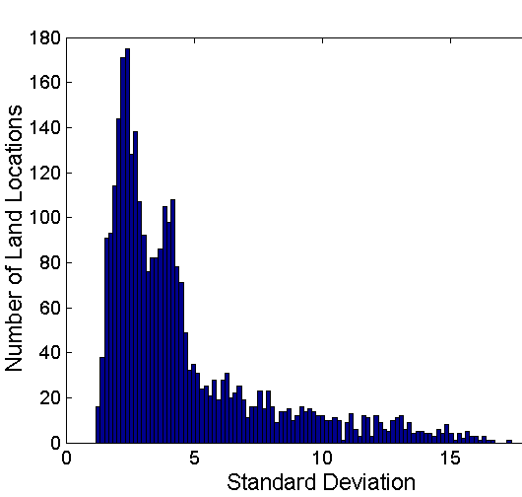
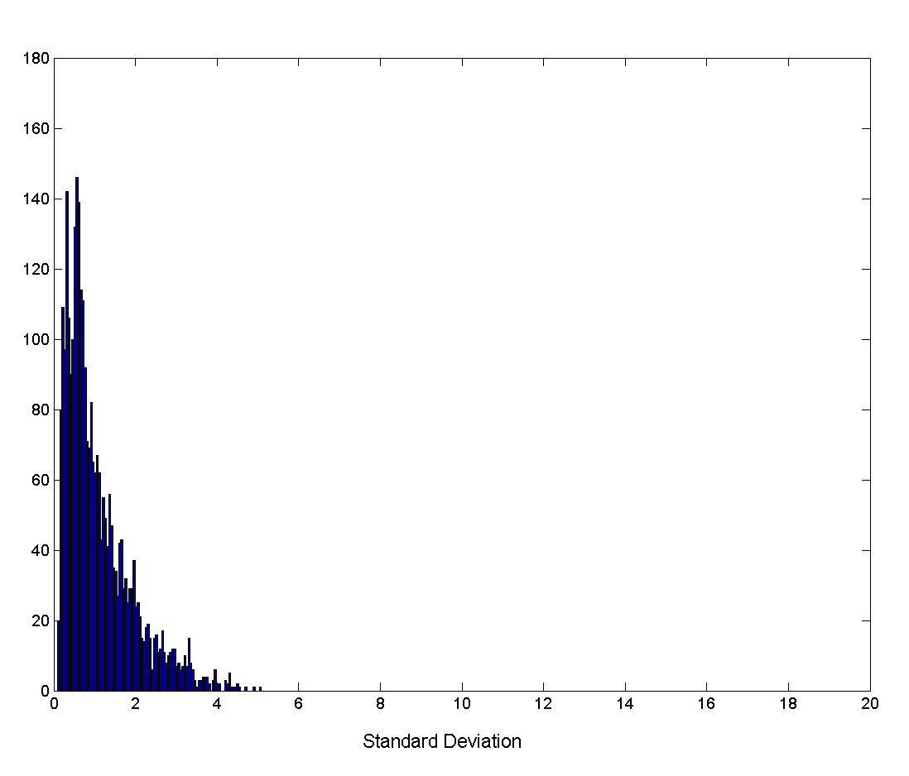
Aggregation
Variation of Precipitation in Australia
Standard Deviation of Average Monthly Precipitation
Standard Deviation of Average Yearly Precipitation

Slide 93
Data Reduction Strategies
A data warehouse may store terabytes of data
Complex data analysis/mining may take a very long time to run on the complete data set
Data reduction
Obtain a reduced representation of the data set that is much smaller in volume but yet produce the same (or almost the same) analytical results
Data reduction strategies
Data cube aggregation
Dimensionality reduction — remove unimportant attributes
Data Compression
Numerosity reduction — fit data into models
Discretization and concept hierarchy generation

Slide 94
Data Cube Aggregation
The lowest level of a data cube
The aggregated data for an individual entity of interest
E.g., a customer in a phone calling data warehouse.
Multiple levels of aggregation in data cubes
Further reduce the size of data to deal with
Reference appropriate levels
Use the smallest representation which is enough to solve the task
Queries regarding aggregated information should be answered using data cube, when possible

Slide 95
Dimensionality Reduction
Feature selection (i.e., attribute subset selection):
Select a minimum set of features such that the probability distribution of different classes given the values for those features is as close as possible to the original distribution given the values of all features
reduce # of patterns in the patterns, easier to understand
Heuristic methods (due to exponential # of choices):
step-wise forward selection
step-wise backward elimination
combining forward selection and backward elimination
decision-tree induction

Slide 96
Data Compression
String compression
There are extensive theories and well-tuned algorithms
Typically, lossless
But only limited manipulation is possible without expansion
Audio/video compression
Typically, lossy compression, with progressive refinement
Sometimes small fragments of signal can be reconstructed without reconstructing the whole
Time sequence is not audio
Typically, short and vary slowly with time

Slide 97
Data Compression
Original Data
Compressed
Data
lossless
Original Data
Approximated
lossy

Slide 98
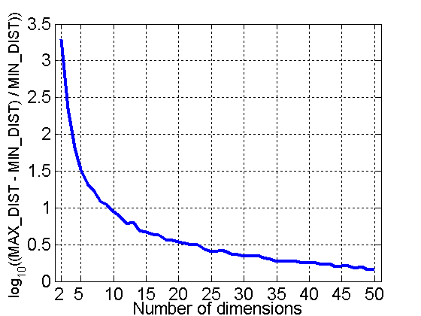
Curse of Dimensionality
When dimensionality increases, data becomes increasingly sparse in the space that it occupies
Definitions of density and distance between points, which is critical for clustering and outlier detection, become less meaningful
Randomly generate 500 points
Compute difference between max and min distance between any pair of points

Slide 99
Dimensionality Reduction
Purpose:
Avoid curse of dimensionality
Reduce amount of time and memory required by data mining algorithms
Allow data to be more easily visualized
May help to eliminate irrelevant features or reduce noise
Techniques
Principle Component Analysis
Singular Value Decomposition
Others: supervised and non-linear techniques

Slide 100
Principal Component Analysis
X2
Y1
Y2
X1

Slide 101
Dimensionality Reduction: PCA
Goal is to find a projection that captures the largest amount of variation in data
x₂
e
x₁

Slide 102
Dimensionality Reduction: PCA
Find the eigenvectors of the covariance matrix
The eigenvectors define the new space
x₂
e
x₁

Slide 103
Principal Component Analysis
Given N data vectors from k-dimensions, find c ≤ k orthogonal vectors that can be best used to represent data
The original data set is reduced to one consisting of N data vectors on c principal components (reduced dimensions)
Each data vector is a linear combination of the c principal component vectors
Works for numeric data only
Used when the number of dimensions is large

Slide 104
Dimensionality reduction: PCA

Slide 105
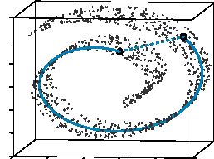
Dimensionality Reduction: ISOMAP
Construct a neighbourhood graph
For each pair of points in the graph, compute the shortest path distances – geodesic distances
By: Tenenbaum, de Silva, Langford (2000)

Slide 106
Feature Subset Selection
Another way to reduce dimensionality of data
Redundant features
duplicate much or all of the information contained in one or more other attributes
Example: purchase price of a product and the amount of sales tax paid
Irrelevant features
contain no information that is useful for the data mining task at hand
Example: students' ID is often irrelevant to the task of predicting students' GPA

Slide 107
Feature Subset Selection
Techniques:
Brute-force approch:
Try all possible feature subsets as input to data mining algorithm
Embedded approaches:
Feature selection occurs naturally as part of the data mining algorithm
Filter approaches:
Features are selected before data mining algorithm is run
Wrapper approaches:
Use the data mining algorithm as a black box to find best subset of attributes

Slide 108
Feature Creation
Create new attributes that can capture the important information in a data set much more efficiently than the original attributes
Three general methodologies:
Feature Extraction
domain-specific
Mapping Data to New Space
Feature Construction
combining features

Slide 109
Sampling
Allow a mining algorithm to run in complexity that is potentially sub-linear to the size of the data
Choose a representative subset of the data
Simple random sampling may have very poor performance in the presence of skew
Develop adaptive sampling methods
Stratified sampling:
Approximate the percentage of each class (or subpopulation of interest) in the overall database
Used in conjunction with skewed data
Sampling may not reduce database I/Os (page at a time).

Slide 110
Sampling
Sampling is the main technique employed for data selection.
It is often used for both the preliminary investigation of the data and the final data analysis.
Statisticians sample because obtaining the entire set of data of interest is too expensive or time consuming.
Sampling is used in data mining because processing the entire set of data of interest is too expensive or time consuming.

Slide 111
Sampling
The key principle for effective sampling is the following:
using a sample will work almost as well as using the entire data sets, if the sample is representative
A sample is representative if it has approximately the same property (of interest) as the original set of data

Slide 112
Types of Sampling
Simple Random Sampling
There is an equal probability of selecting any particular item
Sampling without replacement
As each item is selected, it is removed from the population
Sampling with replacement
Objects are not removed from the population as they are selected for the sample.
In sampling with replacement, the same object can be picked up more than once
Stratified sampling
Split the data into several partitions; then draw random samples from each partition

Slide 113

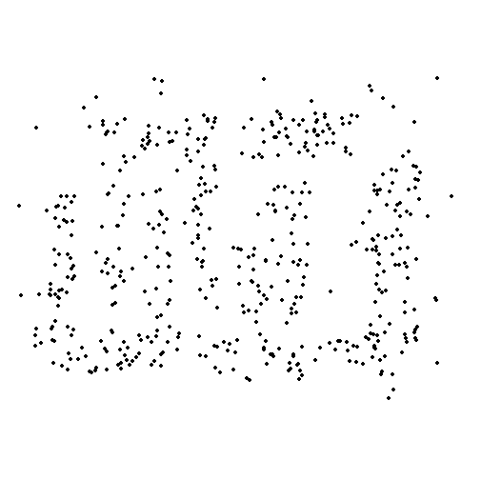
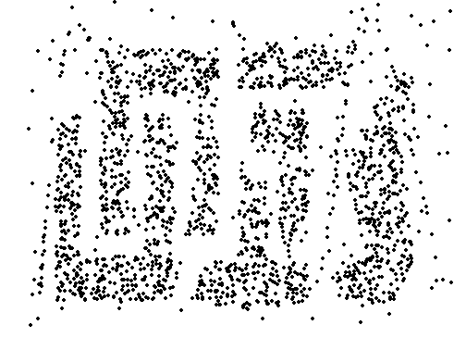
Sample Size
8000 points 2000 Points 500 Points

Slide 114
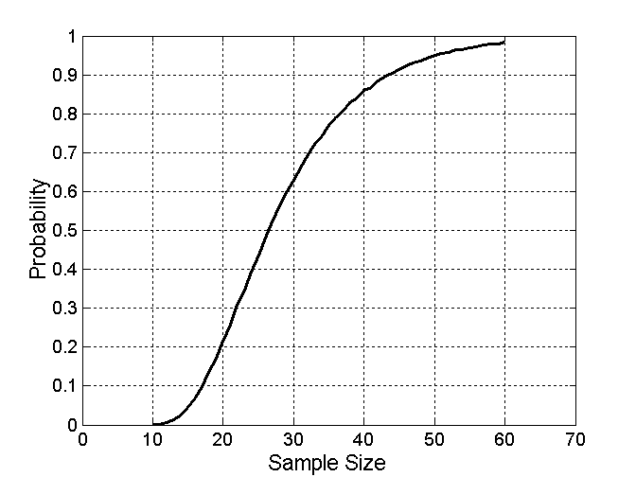

Sample Size
What sample size is necessary to get at least one object from each of 10 groups.

Slide 115
Discretization
Three types of attributes:
Nominal — values from an unordered set
Ordinal — values from an ordered set
Continuous — real numbers
Discretization:
divide the range of a continuous attribute into intervals
Some classification algorithms only accept categorical attributes.
Reduce data size by discretization
Prepare for further analysis

Slide 116
Discretization and Concept hierachy
Discretization
reduce the number of values for a given continuous attribute by dividing the range of the attribute into intervals. Interval labels can then be used to replace actual data values
Concept hierarchies
reduce the data by collecting and replacing low level concepts (such as numeric values for the attribute age) by higher level concepts (such as young, middle-aged, or senior)

Slide 117
Discretization and Concept Hierarchy Generation for Numeric Data
Binning (see sections before)
Histogram analysis (see sections before)
Clustering analysis (see sections before)
Entropy-based discretization
Segmentation by natural partitioning

Slide 118
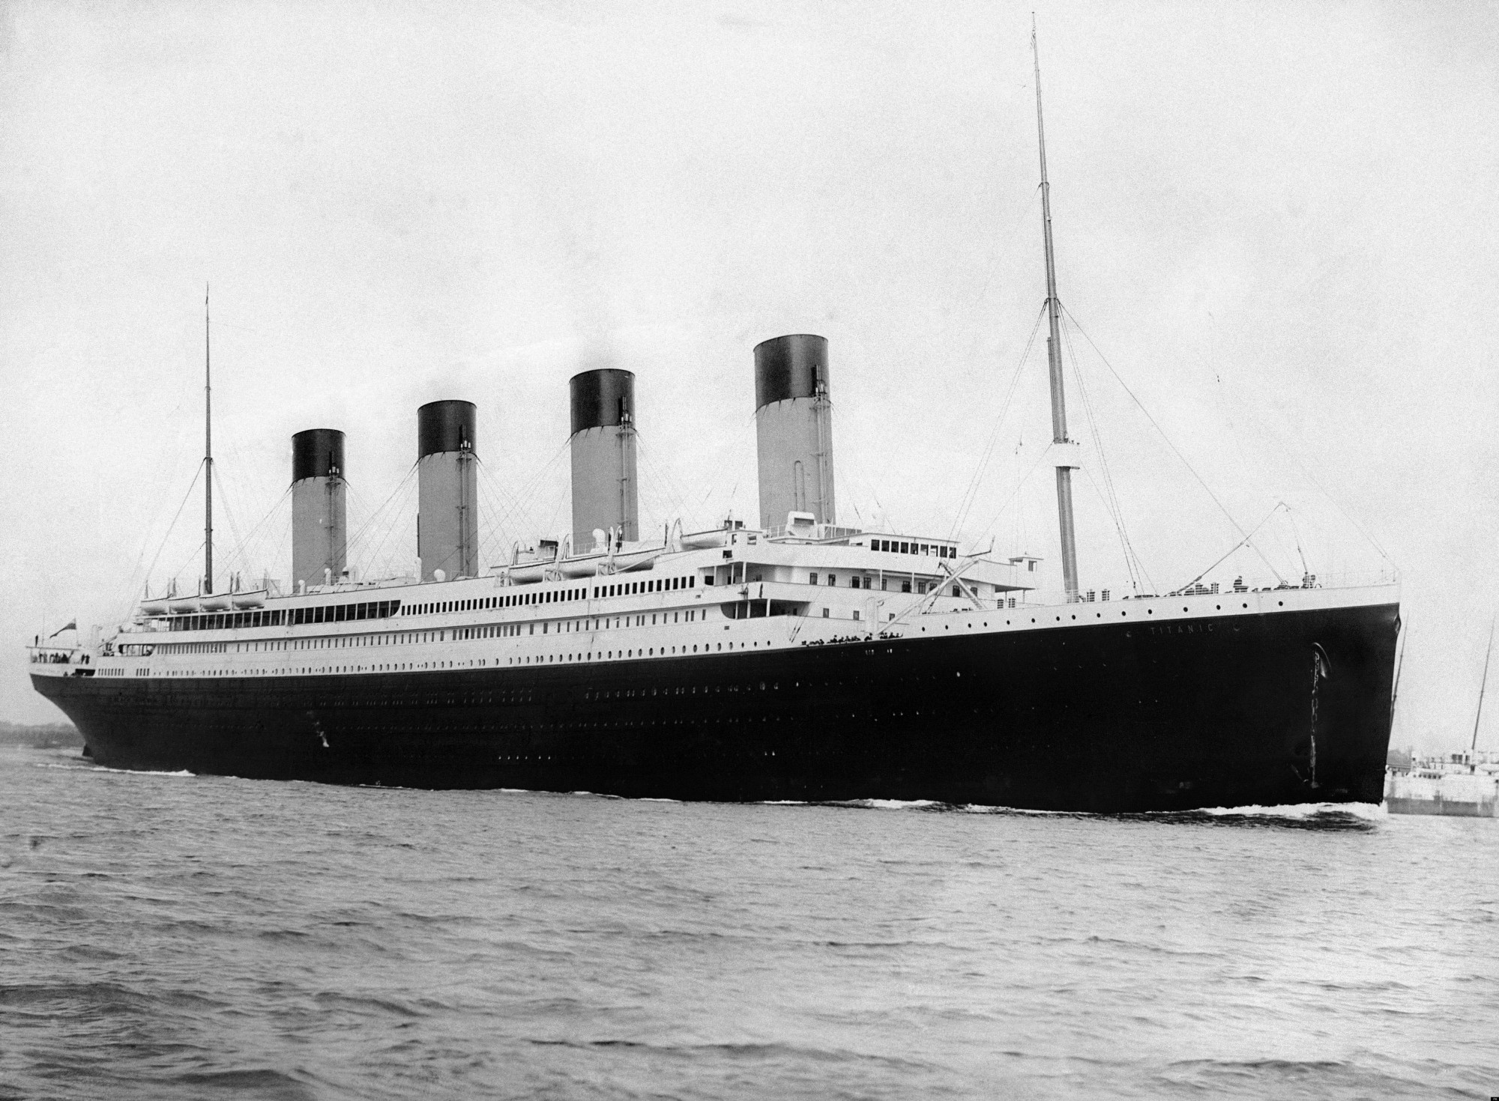
Actividad 1 - Titanic
El RMS Titanic​ fue un transatlántico británico, el mayor barco de pasajeros del mundo al finalizar su construcción, que se hundió durante la noche del 14 y la madrugada del 15 de abril de 1912 durante su viaje inaugural desde Southampton a Nueva York. En el hundimiento del Titanic murieron 1496 personas de las 2208 que iban a bordo, lo que convierte a esta catástrofe en uno de los mayores naufragios de la historia ocurridos en tiempos de paz. Entre sus pasajeros estaban algunas de las personas más ricas del mundo, además de cientos de inmigrantes de nacionalidad irlandesa, británica y escandinava que iban en busca de una mejor vida en Norteamérica.
El barco fue diseñado para ser lo último en lujo y comodidad, y contaba con gimnasio, piscina cubierta, biblioteca, restaurantes de lujo y opulentos camarotes para los viajeros de primera clase, así como con una potente estación de telegrafía disponible para el uso de pasajeros y tripulantes. Sumado a todo esto, el barco estaba equipado con algunas medidas de seguridad avanzadas para la época, como los mamparos de su casco y compuertas estancas activadas a distancia. Sin embargo otras medidas resultaron insuficientes ya que solo portaba botes salvavidas para 1178 pasajeros, poco más de la mitad de los que iban a bordo en su viaje inaugural y un tercio de su capacidad total de 3547 personas.
Notes:
¿Qué elementos consideran los estudiantes que incidieron en la supervivencia en el titanic?

Slide 119
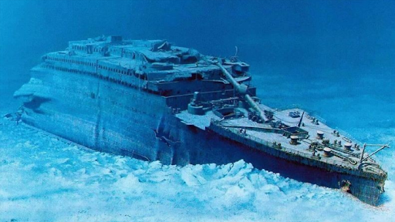
Actividad 1 - Titanic
Tras zarpar de Southampton el 10 de abril de 1912, el Titanic recaló en Cherburgo (Francia) y en Queenstown (actual Cobh) en Irlanda, antes de poner rumbo al océano Atlántico. A las 23:40 del 14 de abril, cuatro días después de zarpar y a unos 600 km al sur de Terranova, el Titanic chocó con un iceberg. La colisión abrió varias planchas del casco en el lado de estribor bajo la línea de flotación, a lo largo de cinco de sus dieciséis mamparos, que comenzaron a inundarse. Durante dos horas y media, el barco se fue hundiendo gradualmente por su sección de proa mientras la popa se elevaba, y en este tiempo varios cientos de pasajeros y tripulantes fueron evacuados en los botes salvavidas, de los cuales casi ninguno fue llenado hasta su máxima capacidad. Un número muy elevado de hombres perecieron debido al estricto protocolo de salvamento que se siguió en el proceso de evacuación, conocido como «Las mujeres y los niños primero». Poco antes de las 2:20 del 15 de abril, el barco se partió en dos y se hundió con cientos de personas todavía a bordo. La mayoría de los que quedaron flotando en la superficie fallecieron de hipotermia, aunque algunos consiguieron ser rescatados por los botes salvavidas. Los 712 supervivientes fueron recogidos por el transatlántico RMS Carpathia unas horas después.
Los restos del Titanic fue descubierto el 1 de septiembre de 1985 por el oceanógrafo estadounidense Robert Ballard en el fondo del Atlántico Norte a una profundidad de 3784 metros. Los restos están muy dañados y sufren un progresivo deterioro, pero desde su descubrimiento han sido recuperados miles de objetos del barco del fondo del mar y estos están en exposición en numerosos museos del mundo.
Notes:
¿Qué elementos consideran los estudiantes que incidieron en la supervivencia en el titanic?

Slide 120
Actividad 1 - Titanic
¿Cuáles eran los tipos de pasajeros (edades, género, clase...) en el Titanic?
¿Cuál es la cubierta de los pasajeros y cómo se relaciona con la clase y el índice de supervivencia?
¿Cuál es el lugar de embarque de los pasajeros?
¿Cuántas personas viajaban solas o con familia y qué relación tiene con la supervivencia?
¿Qué factores ayudaron a alguien a sobrevivir al hundimiento?

